Slide 1
11.1 Introduction to Servlets
- A servlet is a Java object that responds to HTTP
requests and is executed on a Web server
- Servlets are managed by the servlet container, or
servlet engine
- When the Web server receives a request that is for
a servlet, the request is passed to the servlet
container
- The container makes sure the servlet is loaded
and calls it
- The servlet call has two parameter objects, one
with the request and one for the response
- When the servlet is finished, the container
reinitializes itself and returns control to the Web
server

Slide 2
11.1 Introduction to Servlets (continued)
- Servlet uses:
1. to dynamically generate responses to browser
requests
2. as alternatives to Apache modules
- All servlets are classes that either implement the
Servlet interface or extend a class that implements
the Servlet interface
- Most user-written servlet classes are extensions
to HttpServlet (which is an extension of
GenericServlet, which implements the Servlet
Interface)

Slide 3
11.1 Introduction to Servlets (continued)
- Two other necessary interfaces:
- ServletRequest – to encapsulate the
communications, client to server
- ServletResponse – to encapsulate the
communications, server to client
- Provides servlet access to
ServletOutputStream
- Every subclass of HttpServlet MUST override at
least one of the methods of HttpServlet
doGet
doPost
doPut
doDelete

Slide 4
11.1 Introduction to Servlets (continued)
- The protocol of doGet is:
protected void doGet(HttpServletRequest request,
HttpServletResponse response)
throws ServletException, java.io.IOException
- ServletException is thrown if the GET request
could not be handled
- The protocol of doPost is similar
- Servlet output – HTML
1. Use the setContentType method of the response
object to set the content type to text/html
response.setContentType("text/html");
2. Create a PrintWriter object with the getWriter
method of the response object
PrintWriter servletOut =
response.getWriter();

Slide 5
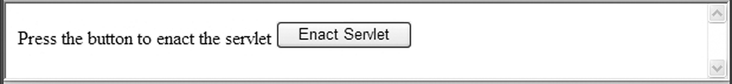
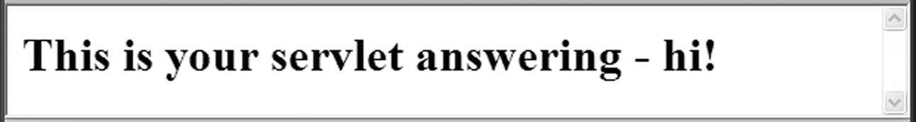
11.1 Introduction to Servlets (continued)
- Example – Respond to a GET request with no data
SHOW tst_greet.html and Greet.java
- Our servlet is written against the “old” servlet spec
- Not portable among servlet containers
- Since late 2003 (Servlet 2.4), a servlet needs a
deployment descriptor document, web.xml, and it
must be packaged in a Web Application Archive
(WAR) file
- Servlet Containers
- Apache Tomcat
- GlassFish – an application server for J2EE
→ SHOW Figure 11.3

Slide 6
11.2 NetBeans
- Prior to Servlet 2.4 spec in late 2003, building servlet
applications was relatively simple – use Tomcat
- Deployment became far more complex when other
servlet containers appeared
- In response, a standard way to package and
deploy servlet applications was developed –
WAR files
- The structure of a WAR file is complicated, so
many developers now use a framework
- NetBeans 7.0
- Initial screen:
→ SHOW Figure 11.4
- New Project screen:
→ SHOW Figure 11.5
- New Web Application screen:
→ SHOW Figure 11.6

Slide 7
11.2 NetBeans (continued)
- Enter the project name, greetn, and click Next
- Brings up the Server and Settings screen
- Click Finish to get the workspace with a skeletal
version of the initial markup document (index.jsp)
→ SHOW Figure 11.7
- Edit index.jsp to have the body of tstGreet.html
- The modified document can be cleaned up by
selecting Source/Format
- Save it by selecting File/Save
- Verify its display with Run/Run Main Project
- To create the servlet, right click the project name
and select New/Servlet, which produces the
New Servlet screen
→ SHOW Figure 11.9
- Enter the name of the servlet, Greet and click
Finish

Slide 8
11.2 NetBeans (continued)
- Much of the skeletal servlet can be removed
- Includes four methods
- To get what we want, we place the central parts of
the Greet.java class into the processRequest
method
- Then we delete some unnecessary comments and
getServletInfo
→ SHOW the completed Greet.java
- If we run the project, we get the same output as
with the non-NetBeans version
- For this trivial application, NetBeans created 15
directories and 21 files

Slide 9
11.3 A Survey Example
- An Example – a survey of potential purchases of
consumer electronics products
→ SHOW index.jsp for survey and its display
- The servlet:
- To accumulate voting totals, it must write a file
on the server
- The file will be read and written as an object
(the array of vote totals) using
ObjectInputStream
- An object of this class is created with its
constructor, passing an object of class
FileInputStream, whose constructor is called
with the file variable name as a parameter
ObjectInputStream indat =
new ObjectInputStream(
new FileInputStream(File_variable_name));
- On input, the contents of the file will be cast to
integer array

Slide 10
11.3 A Survey Example (continued)
- The servlet must access the form data from the
client
- This is done with the getParameter method of the
request object, passing a literal string with the
name of the form element
e.g., if the form has an element named zip
zip = request.getParameter("zip");
- If an element has no value and its value is
requested by getParameter, the returned value
is null

Slide 11
11.3 A Survey Example (continued)
- The file structure is an array of 14 integers, 7 votes
for females and 7 votes for males
- Servlet actions:
If the votes data array exists
read the votes array from the data file
else
create the votes array
Get the gender form value
Get the form value for the new vote and convert it
to an integer
Add the vote to the votes array
Write the votes array to the votes file
Produce the return HTML document that shows
the current results of the survey
- Every voter will get the current totals
→ Show the servlet, Survey.java

Slide 12
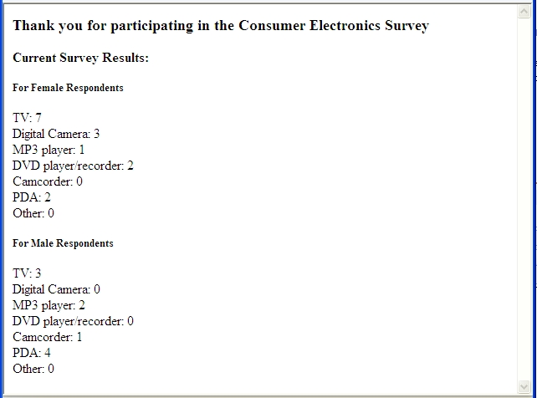
11.3 A Survey Example (continued)

Slide 13
11.4 Storing Information about Clients
- A session is the time span during which a browser
interacts with a particular server
- A session ends when the browser is terminated
or the server terminates it because of inactivity
- The HTTP protocol is stateless
- But, there are several reasons why it is useful for
the server to relate a request to a session
- Shopping carts for many different simultaneous
customers
- Customer profiling for advertising
- Customized interfaces for specific clients
(personalization)
- Approaches to storing client information:
- Store it on the server – too much to store!
- Store it on the client machine - this works
- Cookies
- A cookie is a small object of information sent
between the server and the client

Slide 14
11.4 Storing Information about Clients
(continued)
- Every HTTP communication between the browser
and the server includes information in its header
about the message
- At the time a cookie is created, it is given a
lifetime
- Every time the browser sends a request to the
server that created the cookie, while the cookie
is still alive, the cookie is included
- Servlet Support for Cookies
- A Java cookie is an object of the Cookie class
- Data members to store lifetime, name, and a
value (the cookies’ value)
- Methods: setComment, setMaxAge, setValue,
getMaxAge, getName, and getValue
- Cookies are created with the Cookie constructor
Cookie newCookie = new Cookie(gender, vote);

Slide 15
11.4 Storing Information about Clients
(continued)
- By default, a cookie’s lifetime is the current
session
- If you want it to be longer, use setMaxAge
- A cookie is attached to the response with
addCookie
- Order in which the response must be built:
1. Add cookies
2. Set content type
3. Get response output stream
4. Place info in the response
- The browser does nothing with cookies, other
than storing them and passing them back
- A servlet gets a cookie from the browser with
the getCookies method
Cookie theCookies [];
…
theCookies = request.getCookies();
- A Vote Counting Example
→ Show index.jsp for VoteCounter

Slide 16
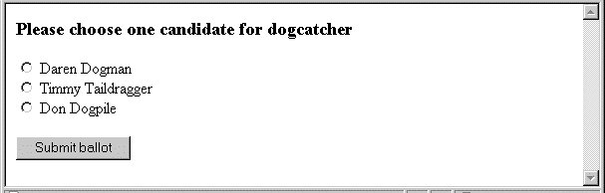
11.4 Storing Information about Clients
(continued)
- Vote counting servlet algorithm:
If the form does not have a vote
return a message to the client – “No vote”
else
If the client did not vote before
If the votes data file exists
read in the current votes array
else
create the votes array
end if
update the votes array with the new vote
write the votes array to disk
return a message to the client, including totals
else
return a message to the client – “Illegal vote”
end if
end if

Slide 17

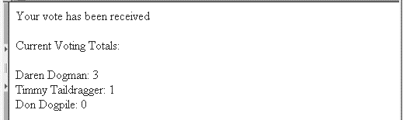
11.4 Storing Information about Clients
(continued)
- The servlet uses two utility methods:
1. A predicate method that determines whether the
client has already voted
2. A method to create the HTML header text
→ Show VoteCounter.java
- No vote:
- Voted before:
- Legal vote:

Slide 18
11.5 Java Server Pages
- Motivation
- Servlets require mixing of HTML into Java
- JSP mixes code into HTML, although the code
can be in a separate file
- JSP Documents (using classic (not XML) syntax)
- Are converted to servlets by the JSP container
→ SHOW Figure 11.16
- Consist of three different kinds of elements:
1. Directives – messages to the JSP container
2. HTML, XHTML, or XML markup – called
template text
- The static part of the document
3. Action elements

Slide 19
11.5 Java Server Pages (continued)
- Action elements
- Dynamically create content
- The output of a JSP document is a combination
of its template text and the output of its action
elements
- Appear in three different categories:
1. Standard – defined by the JSP spec; limited
scope and value
2. Custom – defined by an organization for
their particular needs
3. JSP Standard Tag Library (JSTL) – created
to meet the frequent needs not met by the
standard action elements
- Consists of five libraries
- Differences between JSTL action elements
and a programming language:
1. The syntax is different
2. Action elements are much easier to use
than a programming language

Slide 20
11.5 Java Server Pages (continued)
- Directives
- Tags that use <%@ and %> delimiters
- The most common directives are page and
taglib
- page is used to specify attributes, such as
contentType
<%@ page contentType = ″text/html″ %>
- taglib is used to specify a library of action
elements
<%@ taglib prefix = ″c″
uri = ″http://java.sun.com/jsp/jstl/core″ %>
- JSP Expression Language
- Similar to the expressions of JavaScript
- Has no control statements
- Syntax: ${ expression }

Slide 21
11.5 Java Server Pages (continued)
- JSP Expression Language (continued)
- Consist of literals, arithmetic operators, implicit
variables (for form data), and normal variables
- EL is used to set the attribute values of action
elements (always strings)
- EL data often comes from forms
- The implicit variable, param, stores a
collection of all form data values
${param.address}
- If the form data name has special characters:
${param[′cust-address′]}
- Another implicit variable: pageContext
- Has lots of info about the request
e.g., contentType, contentLength,
remoteAddr

Slide 22
11.5 Java Server Pages (continued)
- JSP Expression Language (continued)
- The value of an EL expression is implicitly
placed in the result document when the
expression is evaluated
- If the text being placed in the document can
include characters that could confuse the
browser (e.g., <, >, etc.), the value is inserted
with the out element
<c:out value = ″${param.address}″ />
- Example – convert Celsius temperatures to
Fahrenheit (tempConvertEL)
- Need a form to get the Celsius temperature from
the user
→ SHOW index.jsp for tempConvertEL
- A second document is used to perform the
conversion and display the result
- The conversion is done using EL
→ SHOW tempConvertEL2.jsp (response doc)

Slide 23
11.5 Java Server Pages (continued)
- JSTL Control Action Elements
- Flow control elements – the Core library of JSTL
- Selection – if element
- Often used to choose whether it is the first call
of a combined document
<c:if test =
″${pageContext.request.method == ′POST′}″>
…
</c:if>
- This selector can be used to build the temperature
conversion application with a single document
→ SHOW index.jsp for tempconvertEL1
- Loops – forEach element (an iterator)
- Often used for checkboxes and menus to
determine the values of the parts
- The paramValues implicit variable has an array
of the values in checkboxes and menus

Slide 24
11.5 Java Server Pages (continued)
- JSTL Control Action Elements (continued)
- forEach has two attributes, items and var,
which get the specific item and its value
- If we had a collection of checkboxes named
topping
<c:forEach items = ″${paramValues.topping}″
var = ″top″>
<c:out value = ″${top}″> <br />
</c:forEach>
- forEach can also be used for counting loops
<c:forEach begin = ″1″ end = ″10″>
…
</c:forEach>
- The choose element – to build switch constructs
- choose, which has no attributes, uses two
other elements, when and otherwise
- when has the test attribute, which has the
control expression
- Radio buttons require a switch construct
→SHOW index.jsp for the radioButtons app

Slide 25
11.6 JavaBeans
- The JavaBeans architecture provides a set of rules
for building a special category of Java classes that
are designed to be reusable stand-alone software
components called beans
- Rigid naming conventions are required to allow
builder tools to determine the methods and data of
a bean class
- All bean data that is to be exposed must have getter
and setter methods whose names must begin with
“get” and “set”, respectively
- The rest of the getter and setter names must be the
data variable’s name
- In JSP, beans are used as containers for data
- They are usually built with a framework
- The contained data are called properties

Slide 26
11.6 JavaBeans (continued)
- The JSP standard element <jsp:useBean> creates
instances of a bean
- Requires two attributes: id and class
- The value of id is a reference to the bean
instance
- The value of class is a package name and the
class name, catenated with a period
e.g., to create an instance of the bean class
named Converter, which is defined in the
package org.mypackage.convert, use:
<jsp:useBean id = ″myBean″ class =
″org.mypackage.convert.Converter″ />

Slide 27
11.6 JavaBeans (continued)
- There are two other standard action elements for
dealing with beans
- <jsp:setProperty> sets a property value in a bean
<jsp:setProperty name = ″myBean″
property = ″sum″
value = ″100″ />
- Often need to move values from a form
component to a bean property
<jsp:setProperty name = ″myBean″
property = ″zip″
param = ″zipcode″ />
- If the form component and the property have the
same name, the param attribute is not required
- All JSP values and all form component values are
strings

Slide 28
11.6 JavaBeans (continued)
- <jsp:getProperty> fetches a property value from a
bean and places it in the JSP document
- Takes two attributes, name and property
<jsp:setProperty name = ″myBean″
property = ″sum″ />
- EL can be used to fetch a property from a bean
${myBean.sum}
- Example – temperature conversion, again
- Project name: tempConvertB
→ SHOW index.jsp for tempConvertB
- The response document (response.jsp)
- Name the package org.mypackage.convert and
the class name Converter
→ SHOW response.jsp for tempConvertB

Slide 29
11.6 JavaBeans (continued)
- Finally, the bean class
- Right click on the project in the Projects list
- Select New/Java class
- Name the class Converter and the package
org.mypackage.convert
- Type the bean into the workspace
→ SHOW Converter.java

Slide 30
11.7 Model-View-Controller Application
Architecture
- MVC cleanly separates applications into three
parts:
- Model – the data and any restraints on it
- View – prepares and presents results to the
user
- Controller – controls the interactions between
the user and the application
- Originally developed for GUI systems, but is useful
for other applications, such as Web applications
- Four approaches to MVC with Java server
software:
1. Pure JSP – separate JSP pages are used for the
controller and view parts; beans for the model
2. Servlets, JSP, + beans – servlets for the
controller, JSP for views, and beans for the
model
3. Servlets, JSP, and EJBs – similar to 2
4. Starting with NetBeans 6.9, Spring Web MVC

Slide 31
11.8 JavaServer Faces
- Provides an event-driven user interface
programming model
- Client-generated events can be connected to
server-side application code
- User interfaces can be constructed with reusable
and extensible components
- User interface state can be saved and restored
beyond the life of the server request
- JSF allows:
1. managing the state of components
2. processing component values
3. validating user input
4. handling user interface events
- JSF uses beans to store and manipulate the values
of components
- Markup documents are HTML, not JSP

Slide 32
11.8 JavaServer Faces (continued)
- Tag Libraries for JSF:
- Core Tags, HTML Tags, and JSF HTML Tags
- Most JSF documents use both
- To gain access to the libraries (namespaces):
<html xmlns = "http://www.w3.org/1999/xhtml"
xmlns:c = "http://java.sun.com/jsf/core"
xmlns:h = "http://java.sun.com/jsf/html" >
- We’ll only use one Core tag, view
- We’ll use three HTML tags, form, outputText, and
inputText
- form is used to provide a container for the user
interface components
- outputText is used to display text or bean
properties
- For literals, the literal is assigned to the value
attribute
- For bean properties, a JSF expression is used

Slide 33
11.8 JavaServer Faces (continued)
- JSF expressions are similar to EL expressions,
except that # is used instead of $
<h:outputText value = "#{MyBean.sum}" />
- inputText is used to specify a text box for user
input
- Like HTML input with type set to "text"
- In most cases, the value is bound to a bean
property, using the value attribute

Slide 34
11.8 JavaServer Faces (continued)
- JSF Event Handling
- Events are defined by either:
- classes that implement listener interfaces
- bean methods
- There are three categories of events in JSF:
value-change, action, and data-model
- Value-change events are raised when the value
of a component is changed
- Action events are raised when a button is clicked
or a hyperlink is activated

Slide 35
11.8 JavaServer Faces (continued)
- An Example – the same one … tempConvertF
- The conversion will be requested when the user
clicks a Faces commandButton, which calls a
bean method
- We use NetBeans, as follows:
1. Select File/New Project
2. Select Java Web and Web Application
3. Click Next, to get the New Web Application
4. Type in the project name tempConvertF2
5. Click Next, to get a Framework screen
6. Select JavaServer Faces and click Finish
This produces a skeletal XHTML document,
index.xhtml

Slide 36
11.8 JavaServer Faces (continued)
<?xml version='1.0' encoding='UTF-8' ?>
<!DOCTYPE html PUBLIC
"-//W3C//DTD XHTML 1.0 Transitional//EN"
"http://www.w3.org/TR/xhtml1/DTD/
xhtml1-transitional.dtd">
<html xmlns="http://www.w3.org/1999/xhtml"
xmlns:h="http://java.sun.com/jsf/html">
<h:head>
<title> Facelet Title </title>
</h:head>
<h:body>
Hello from Facelets
</h:body>
</html>

Slide 37
11.8 JavaServer Faces (continued)
- Add the user interface to the skeletal
document
<?xml version='1.0' encoding='UTF-8' ?>
<!DOCTYPE html PUBLIC "-//W3C//DTD XHTML 1.0 Transitional//EN"
"http://www.w3.org/TR/xhtml1/DTD/xhtml1-transitional.dtd">
<!-- welcome.xhtml - the initial document for the tempConvertF2
project. Displays a text box to collect a temperature in
Celsius from the user, which it then converts to
Fahrenheit with the UserBean method called when the
Convert button is clicked.
-->
<html xmlns="http://www.w3.org/1999/xhtml"
xmlns:h="http://java.sun.com/jsf/html">
<h:head>
<title> Initial document for tempConvertF2 </title>
</h:head>
<h:body>
<h2> Welcome to the Faces temperature converter </h2>
<h:form>
<p>
Enter a temperature in Celsius:
<h:inputText size = "4"
value = "#{userBean.celsius}" />
<br /><br />
<h:commandButton value ="Convert to Fahrenheit"
action ="#{userBean.convert}" />
<br /><br />
The equivalent temperature in Fahrenheit is:
<h:outputText value ="#{userBean.fahrenheit}" />
</p>
</h:form>
</h:body>
</html>

Slide 38
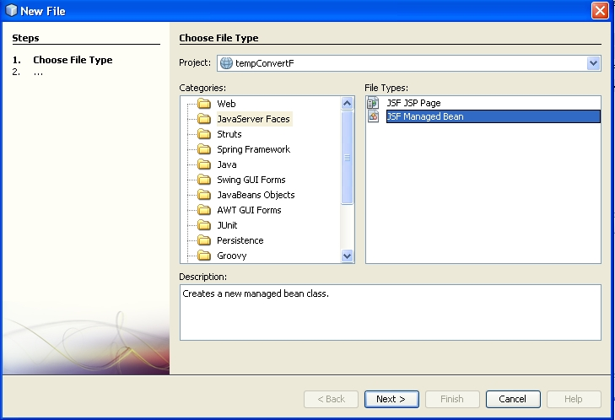
11.8 JavaServer Faces (continued)
- To build the bean:
1. Select File/New File
2. Select JavaServer Faces and JSF Managed Bean

Slide 39
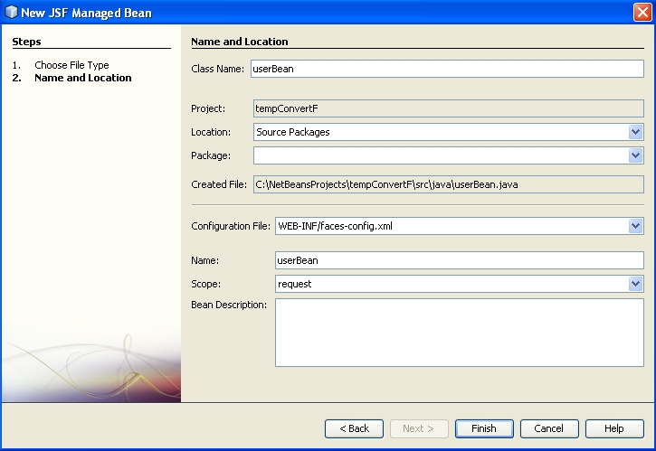
11.8 JavaServer Faces (continued)

Slide 40
11.8 JavaServer Faces (continued)
/*
* To change this template, choose Tools | Templates
* and open the template in the editor.
*/
import javax.faces.bean.ManagedBean;
import javax.faces.bean.RequestScoped;
/**
*
* @author bob2
*/
@ManagedBean
@RequestScoped
public class UserBean {
/** Creates a new instance of UserBean */
public UserBean() {
}
- A managed bean can specify several diferent
scopes
- @RequestScoped specifies that the bean will
be instantiated and stay available through a
single HTTP request

Slide 41
11.8 JavaServer Faces (continued)
/* UserBean.java - the managed bean for the
tempConvertF2 project. Provides storage for the
Celsius and Fahrenheit temperatures and provides
the action method to convert the Celsius
temperature to its equivalent Fahrenheit
temperature
*/
import javax.faces.bean.ManagedBean;
import javax.faces.bean.RequestScoped;
@ManagedBean
@RequestScoped
public class UserBean {
private String celsius;
private String fahrenheit;
public void setCelsius(String temperature) {
this.celsius = temperature;
}
public String getCelsius() {
return celsius;
}
public String getFahrenheit(){
return fahrenheit;
}
public void setFahrenheit(String temperature) {
this.fahrenheit = temperature;
}
public String convert() {
fahrenheit = Float.toString(1.8f *
Integer.parseInt(celsius) + 32.0f);
return fahrenheit;
}
}

Slide 42
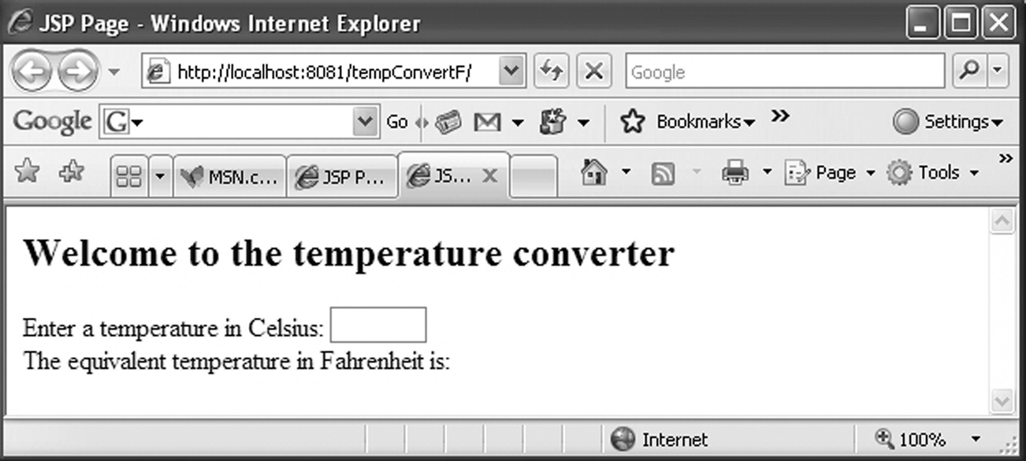
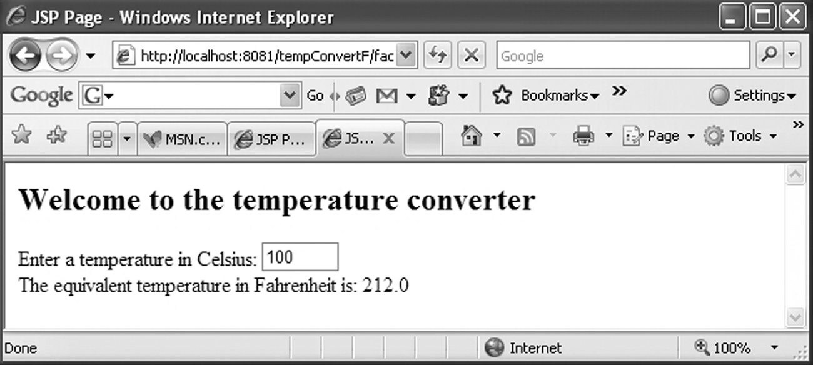
11.8 JavaServer Faces (continued)
- The initial screen:
- The result screen:

